Slide 1


做好开源客服系统
行动号召：给春松客服 Star
github.com/chatopera/cskefu
分享内容在 5 秒后开始

Slide 2

春松客服大讲堂
2019 © 北京华夏春松科技有限公司

Slide 3

春松客服大讲堂
做好开源客服系统
SQL快速入门
王海良
主讲老师/华夏春松联合创始人&CEO
Chatopera 用户群
春松客服，Chatopera 机器人平台用户讨论群
2019 © 北京华夏春松科技有限公司

Slide 4

自我介绍
王海良，Chatopera联合创始人&CEO，微软人工智能
最有价值专家。2011年毕业于北邮，后加入IBM工作四
年，先后工作于软件开发实验室和创新中心。从2016年
开始工作于创业公司，三角兽AI算法工程师，呤呤英语
AI产品负责人，负责智能对话系统研发，2018年出版
《智能问答与深度学习》一书。

Slide 5
分享大纲
春松客服大讲堂
5-1 SQL快速入门
SQL简介
SQL基本语法
SQL高级语法
春松客服数据表

Slide 6
SQL简介
春松客服大讲堂
5-1 SQL快速入门

Slide 7
Structured Query Language
春松客服大讲堂
5-1 SQL快速入门
SQL is a language to operate databases; it includes database creation, deletion, fetching rows, modifying rows, etc.
Notes:
结构化查询语言
s
https://blog.csdn.net/zhanghongju/article/details/3314034
https://theintactone.com/2019/03/27/dbms-u3-topic-1-structured-query-language/
SQL is Structured Query Language, which is a computer language for storing, manipulating and retrieving data stored in a relational database.
SQL is the standard language for Relational Database System. All the Relational Database Management Systems (RDMS) like MySQL, MS Access, Oracle, Sybase, Informix, Postgres and SQL Server use SQL as their standard database language.

Slide 8
SQL Components
春松客服大讲堂
5-1 SQL快速入门
SQL is the standard language for Relational Database System.
Parser + Optimizer
File Manager
Transaction Manager
SQL Query
Query Language
Processor
DBMS Engine
Physical Database
Notes:
当RDBMS执行SQL命令时，系统会找出执行请求的最佳方法，而SQL引擎会确定如何解释该任务。在该过程中，包括各种组件。 这些组件可以是优化引擎，查询引擎，查询调度程序，经典查询引擎等。所有非SQL查询都由经典查询引擎处理，但SQL查询引擎不会处理逻辑文件。
https://blog.csdn.net/zhanghongju/article/details/3314034
https://theintactone.com/2019/03/27/dbms-u3-topic-1-structured-query-language/
When you are executing an SQL command for any RDBMS, the system determines the best way to carry out your request and SQL engine figures out how to interpret the task.
There are various components included in this process.
These components are:
Query Dispatcher
Optimization Engines
Classic Query Engine
SQL Query Engine, etc.
A classic query engine handles all the non-SQL queries, but a SQL query engine won’t handle logical files.
Following is a simple diagram showing the SQL Architecture:

Slide 9
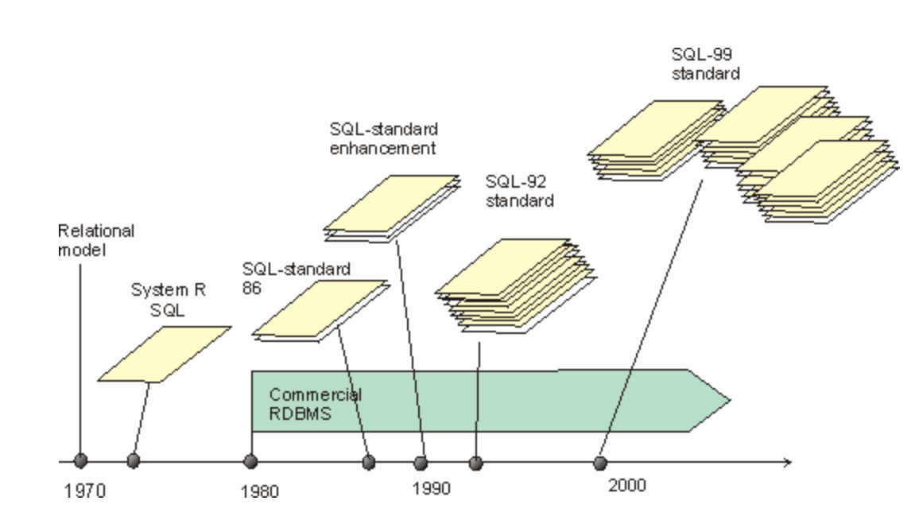
漫长的历史
春松客服大讲堂
5-1 SQL快速入门
Notes:
The SQL language was originally developed at the IBM research laboratory in San José, in connection with a project developing a prototype for a relational database management system called System R in the early 70s.
The first database management systems based on SQL became available commercially by the end of the 70s. At the same time, relational database management systems based on other languages were published. The best known alternative for SQL was the QUEL language in the Ingres system.
SQL was elected for standardization. Both the American ANSI and the international ISO took part in the standardization
In 1986, the first SQL standard was approved (the core SQL about 40 pages + the module language, and embedding in programming languages, altogether about 100 pages)
In 1989, an integrity enhancement was appproved by ISO, containing, among other features, the specification possibility for keys, foreign keys and some other constraints (c. 20 pages)
In 1992, the new version SQL-92 (also called SQL2) was approved. It contained large enhancements to the language. The size of the standard was about. 600 pages + the data dictionary standard; altogether c. 1000 pages. Three levels were specified for SQL
the basic level, mainly containing the core of the old SQL/89
the intermediate level, containing new data types, operations and structures
the full SQL with even more data types and structures
Instead of one massive standard, the decision was taken to continue development in parts.
In 1995, the SQL/CLI call level interface was approved, i.e. the interface specification for use through programs. The standard specifies the ODBC interface.
In 1996, the SQL/PSM (persistent stored modules) was approved as a database procedure specification language.
In 1999, the new version SQL-99 (also called SQL3) was approved. The standard is divided into five parts.
Framework (introduction)
Foundation (core)
CLI (call level interface)
PSM (persistent stored modules)
Bindings (to programming languages)
Altogether, the standard is about 2,100 pages long. It contains large enhancements to the 92 standard, such as new data types, database procedures and triggers, object oriented features, more comprehensive integrity checks, recursive queries, and data warehouse functions. Due to the new features SQL-99 is quite far from the principles of the relational model of data.
The conformance to the standard is no longer based on levels but there is a core, to which additional features can be added as packages.
The embedding of SQL into a Java program (SQLJ) was approved on 2000. At least the standards for multimedia enhancements and data warehouse features are being developed.

Slide 10
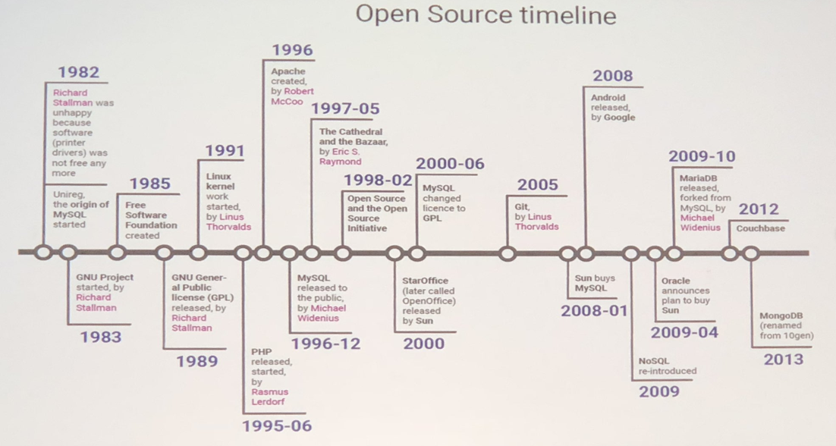
MySQL的历史
春松客服大讲堂
5-1 SQL快速入门

Slide 11
本节前提准备
春松客服大讲堂
5-1 SQL快速入门
Git
Linux Bash or Git Bash(For Windows)
Docker & Docker Compose
MySQL Workbench or Navicat for MySQL

Slide 12
下载示例源码
春松客服大讲堂
5-1 SQL快速入门
git clone https://github.com/Samurais/sql-in-10-mins.git
SQL 必知必会(第四版)
根据该书随书源码以及一些修改

Slide 13
准备练习数据表结构(ER)
春松客服大讲堂
5-1 SQL快速入门
Notes:
ER Mapping
Entity–relationship model, ER模型，全称为实体联系模型、实体关系模型或实体联系模式图
是概念数据模型的高层描述所使用的数据模型或模式图。 ER模型常用于信息系统设计中；比如它们在概念结构设计阶段用来描述信息需求和／或要存储在数据库中的信息的类型。但是数据建模技术可以用来描述特定论域的任何本体
父子关系：
Customers(父) → cust_id -> Orders(子)
Orders(父) -> order_num -> OrderItem(子)
Products(父) -> prod_id -> OrderItem(子)
Vendors(父) → vend_id -> Products(子)

Slide 14
准备练习环境
春松客服大讲堂
5-1 SQL快速入门
启动MySQL Server
在Navicat中连接MySQL Server
创建练习Database
导入数据到练习Database
Notes:
演示脚本：
tutorials/001.create.sql
tutorials/001.populate.sql
此处只需要执行脚本，不需要讲解

Slide 15
SQL基本语法
春松客服大讲堂
5-1 SQL快速入门

Slide 16
基本语法
春松客服大讲堂
5-1 SQL快速入门
table
query
insert
create
update
select
rename
order by
delete
alter
where
drop
like
function
Notes:
https://www.w3schools.com/sql/default.asp
Table:
tutorials/017.table.sql
Query:
tutorials/ 002.select_from.sql - 009.max_min_avg.sql
Insert: tutorials/015.insert.sql ; Update & Delete: tutorials/016.update_del.sql

Slide 17
SQL高级语法
春松客服大讲堂
5-1 SQL快速入门
Notes:
相对高级，SQL的原理简单，但是在不同数据库上有很多定制功能，如函数，句法，数据库管理属于易学难精。
很多应用的瓶颈都是在数据库。

Slide 18
高级语法
春松客服大讲堂
5-1 SQL快速入门
select
view
group by
procedure
having
subquery
join
union
Notes:
https://www.w3schools.com/sql/default.asp
Group By & Having: tutorials/010.group_by.sql
Groupby 返回分组
SubQuery: tutorials/011.subquery.sql
Join: tutorials/012.join.sql
连接主要是方便处理基表中空值的情况，根据right或left确定基表
Union: 合集
tutorials/014.union.sql

Slide 19
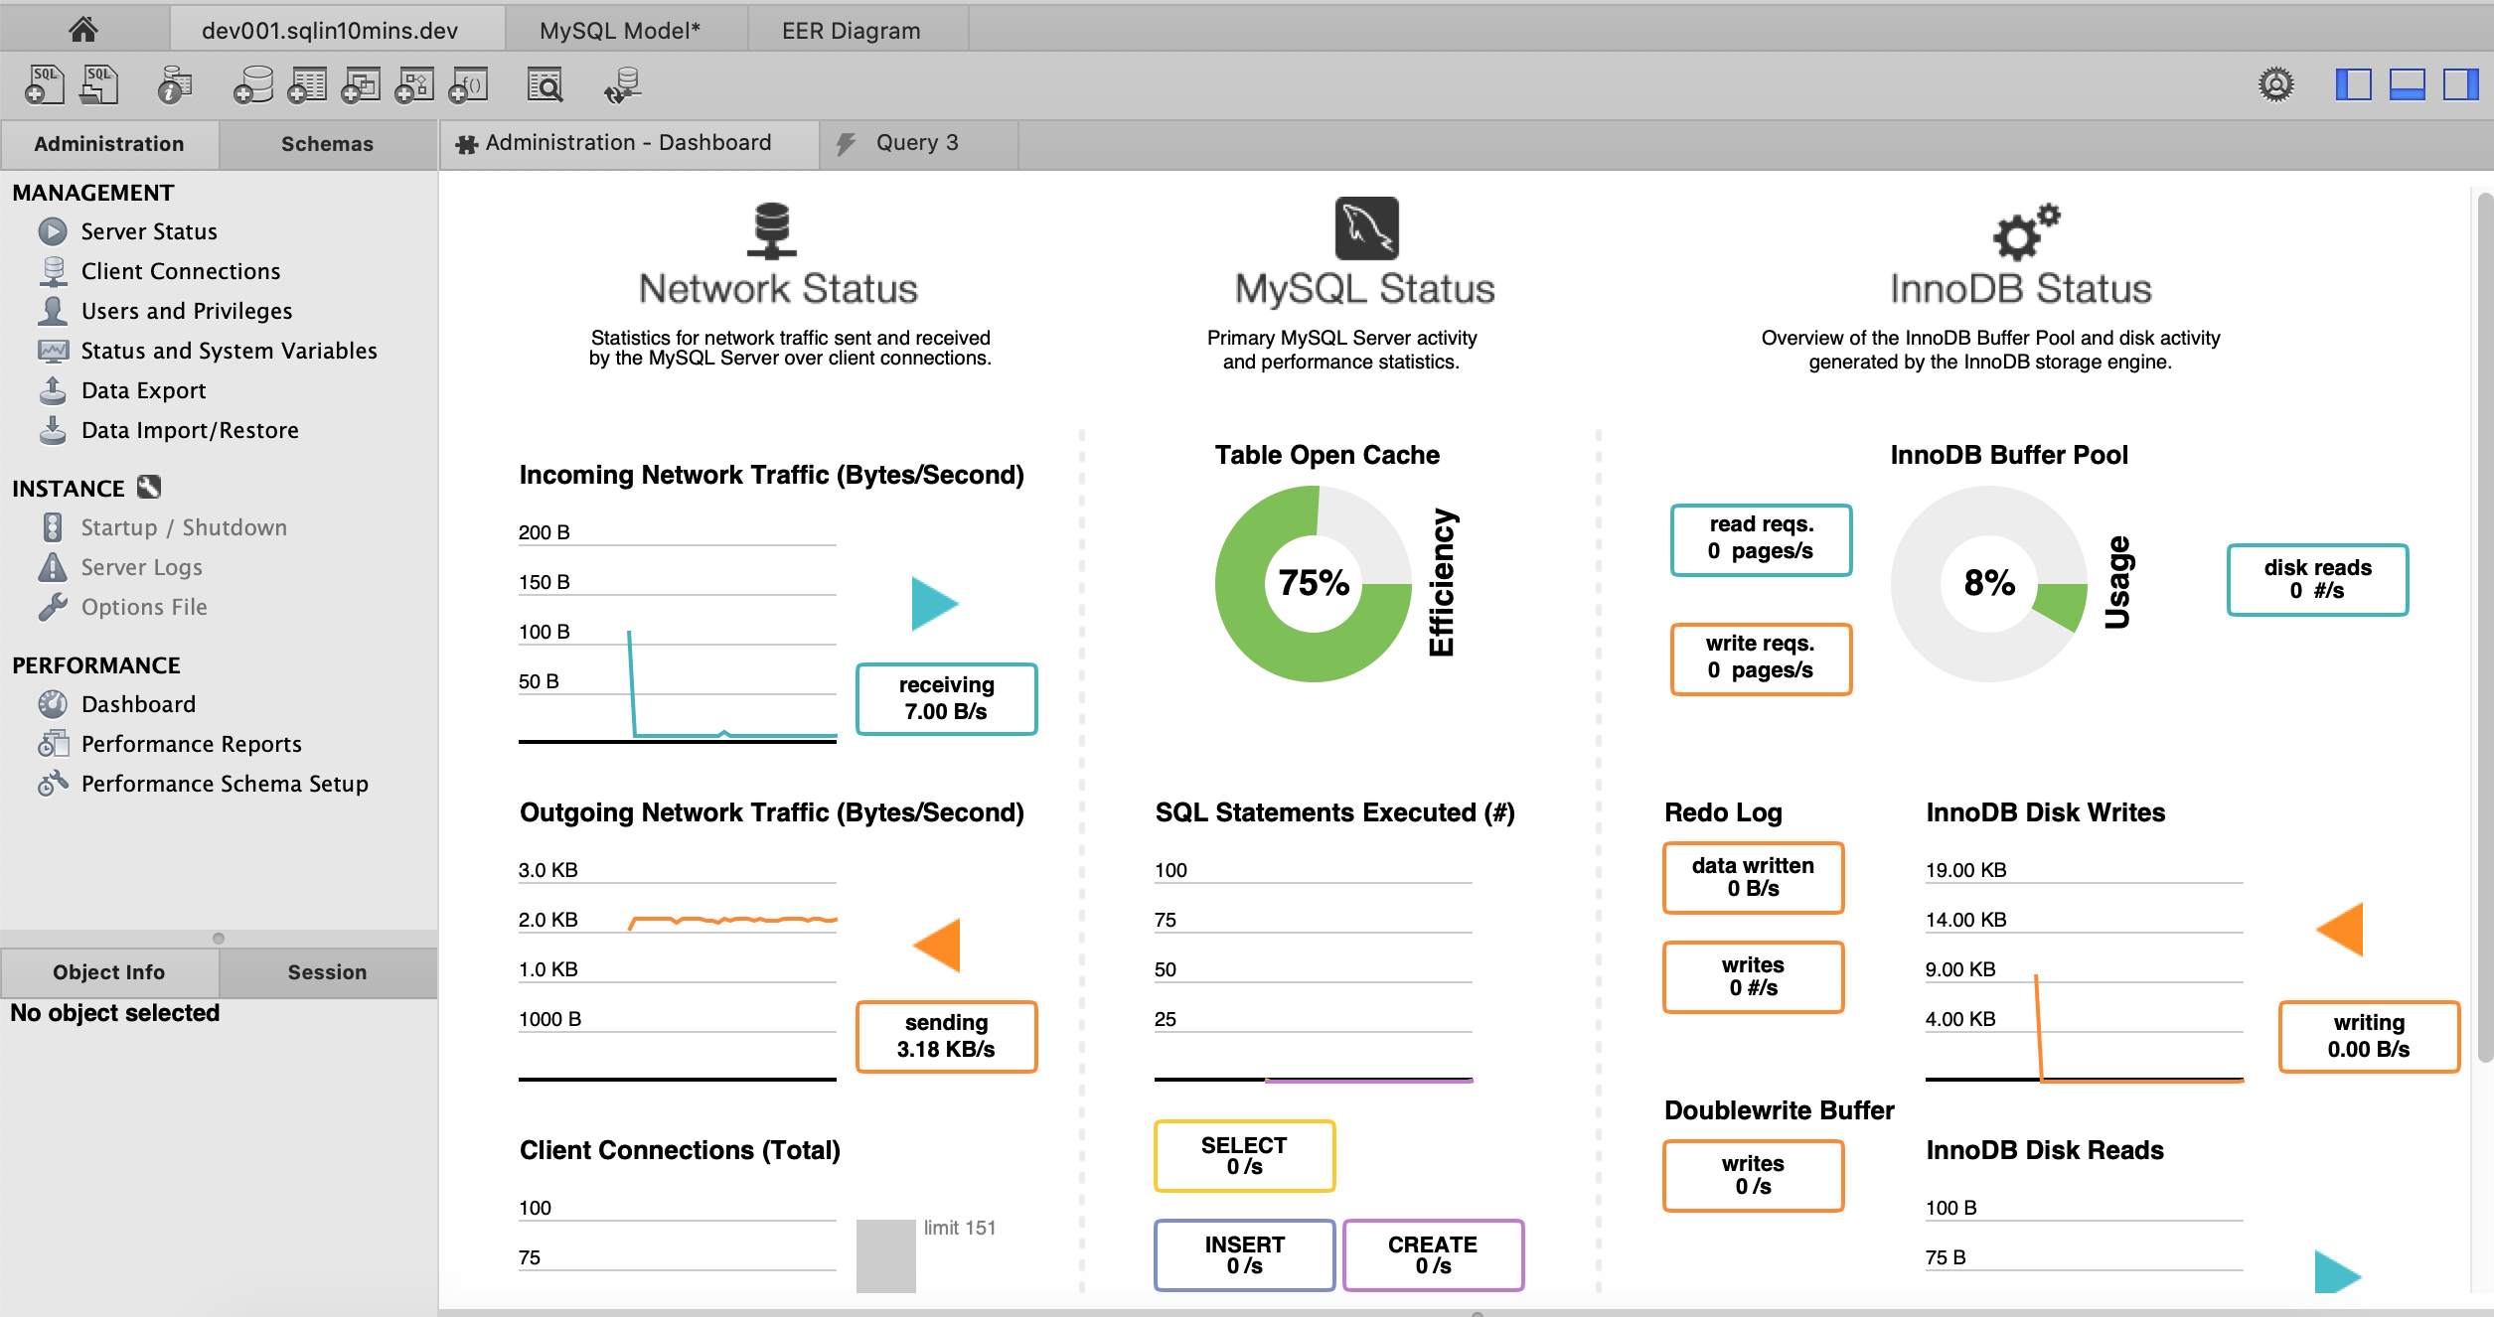
MySQL 运维管理
春松客服大讲堂
5-1 SQL快速入门

Slide 20
春松客服数据表
春松客服大讲堂
5-1 SQL快速入门

Slide 21
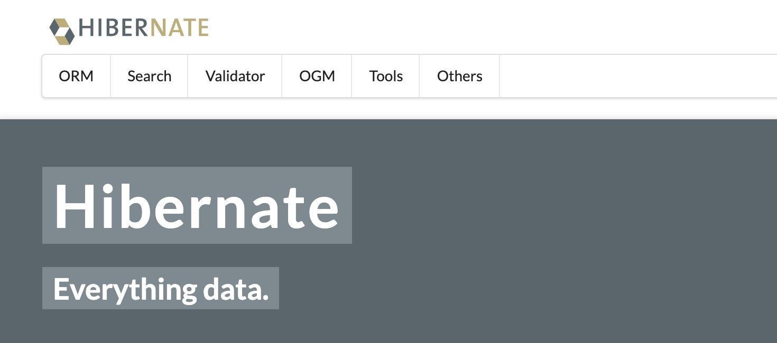
对象关系映射(OR Mapping)
春松客服大讲堂
5-1 SQL快速入门
Object Relational Mapping是一种程序设计技术，用于实现面向对象编程语言里不同类型系统的数据之间的转换。
Notes:
是一种程序设计技术，用于实现面向对象编程语言里不同xq类型系统的数据之间的转换。

Slide 22
SQL表结构初始化
春松客服大讲堂
5-1 SQL快速入门
初始化脚本
contact-center/config/sql/cosinee-MySQL-slim.sql
查看Hibernate数据库脚本执行
Properties: spring.jpa.show-sql=true
OR
环境变量：SPRING_JPA_SHOW_SQL=true
Logger level INFO
Notes:
1）讲解
contact-center/config/sql/cosinee-MySQL-slim.sql
2) 讲解
在源码中查看Model
3）讲解
查看数据SQL执行情况
设置环境变量
spring.jpa.show-sql=true
Logger level INFO
SPRING_JPA_SHOW_SQL=true

Slide 23
源码导读
春松客服大讲堂
5-1 SQL快速入门

Slide 24
代码结构
春松客服大讲堂
3.2 春松客服的运维管理
Templates
Controller
Proxy
Model
Database

Slide 25


做好开源客服系统
Chatopera 公众号
Chatopera 用户群
最新更新，动态
春松客服，Chatopera 机器人平台用户讨论群
2019 © 北京华夏春松科技有限公司

Slide 26
资源
文档中心: https://docs.chatopera.com
开源地址: http://github.com/chatopera
春松客服: https://github.com/chatopera/cskefu
博客地址: https://blog.chatopera.com
Chatopera云服务: https://bot.chatopera.com/
2019 © 北京华夏春松科技有限公司

